Slide 1
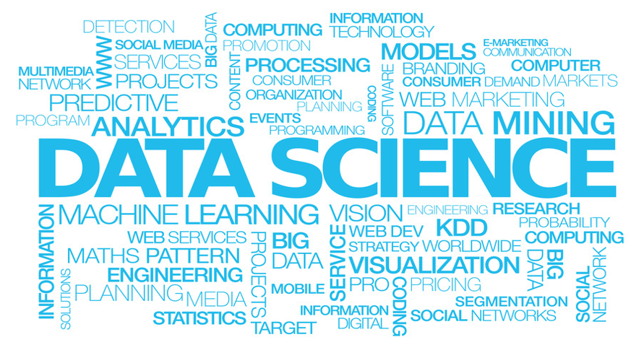
Cloud-enabled Data Science
Jia, Lucas, Eric, Sunil

Slide 2

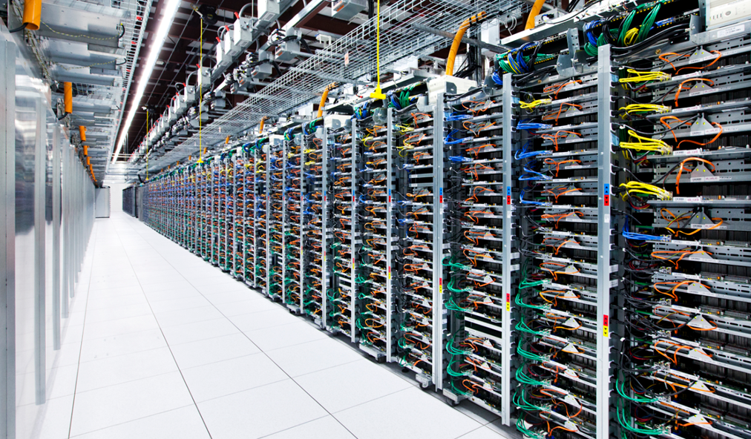
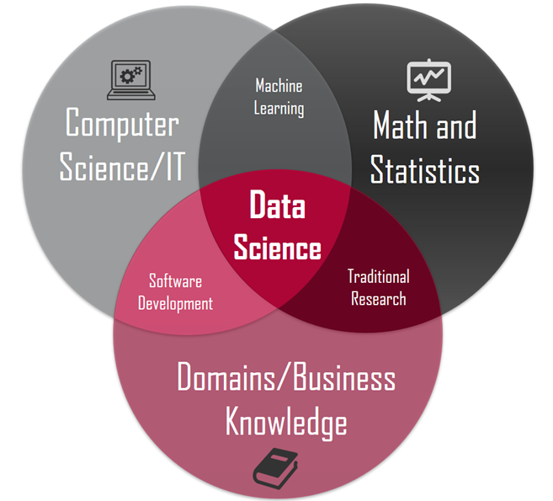
Making sense of data ….
… requires skill & computing resources

Slide 3
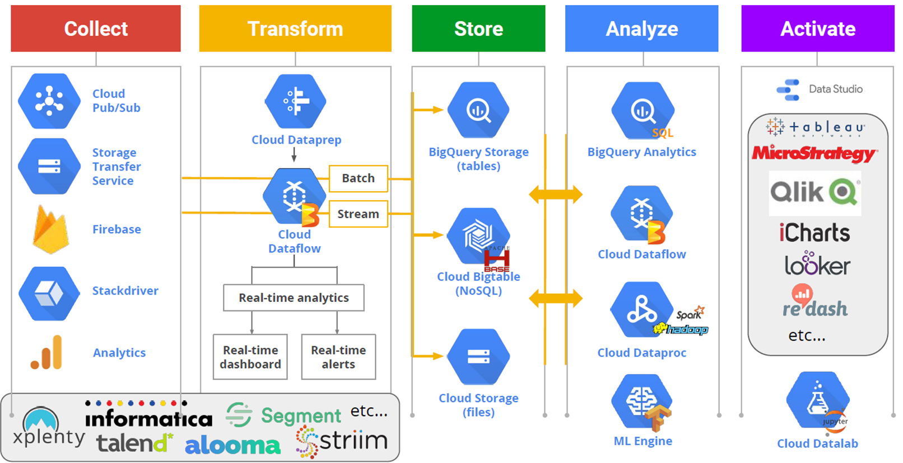
Cloud As A Key Enabler for Data Science

Slide 4

But there is one problem…
… cloud computing can get very expensive!!

Slide 5

Our mission (and we chose to accept it) is to build a cloud computing dashboard that provides insights into the usage and costs associated with the use of the cloud using data science

